Slide 1
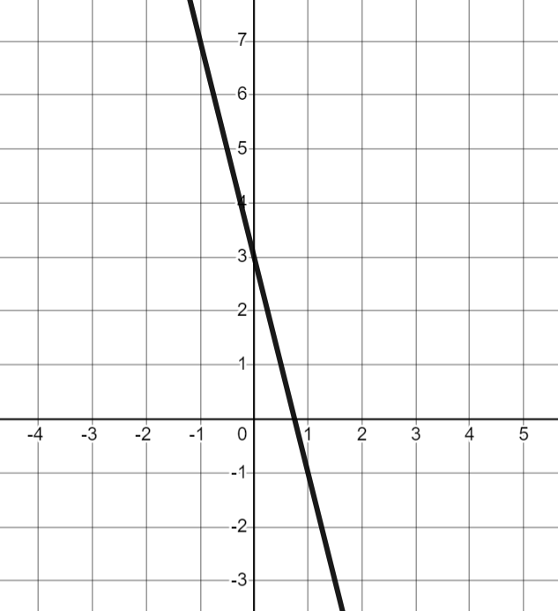
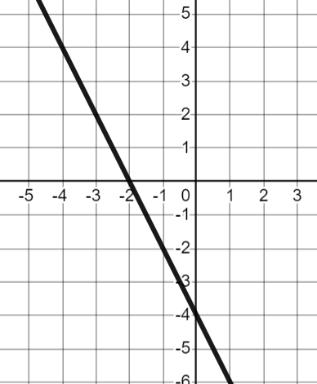
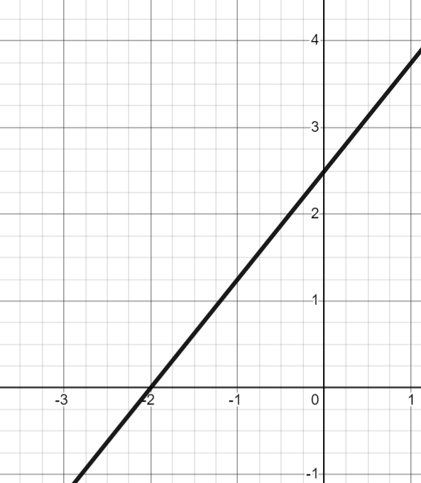
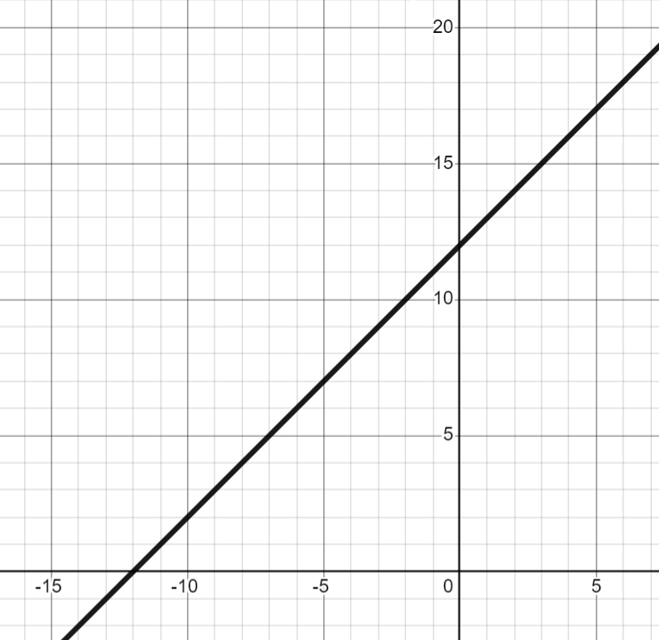
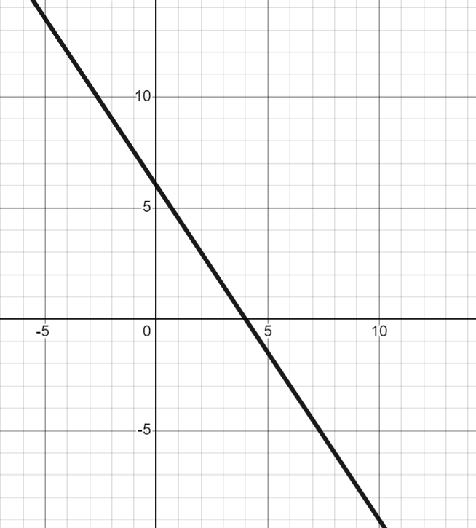
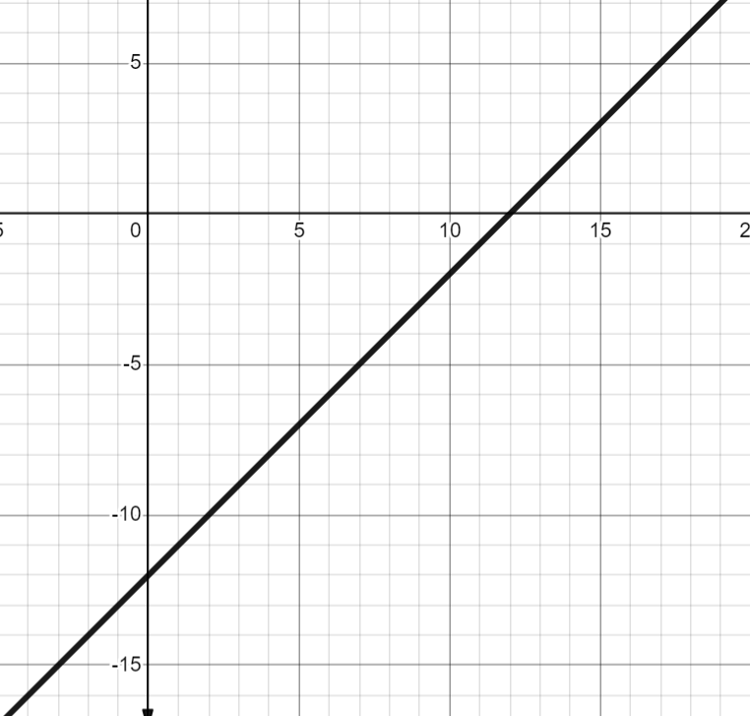
The intercept point
Task A: Identifying the y-intercept
For each question, circle the y-intercept on the graph and in the table.
a) | b) | c)
x | 0 | 1 | 2 | 3
y | 3 | −1 | −5 | −9
x | −2 | −1 | 0 | 1
y | 0 | −2 | −4 | −6
x | −2 | 0 | 2 | 4
y | 0 | 2.5 | 5 | 7.5
2) Write the y-intercept for each as a coordinate.
3) Match each y-intercept to a graph, a table and an equation.
A (0,6)
B (0,12)
C (0,−12)
D
E
F
G
x | 0 | 2 | 4
y | 6 | 3 | 0
H
x | −10 | −5 | 0
y | 2 | 7 | 12
I
x | −1 | 0 | 1
y | −13 | −12 | −11
J
y = x + 12
K
y + 12 = x
L
2y + 3x − 12 = 0

Slide 2
The intercept point
Task B: Calculating the y-intercept from tables of values
For each table of values, work out the y-intercept.
a)
b)
c)
x | 0 | ….. | 2 | 3 | 4
y |  | ….. | 13 | 16 | 19
x | 0 | ….. | 6 | 7 | 8
y |  | ….. | 19 | 21 | 23
x | 0 | ….. | 25 | 26 | 27
y |  | ….. | 17 | 21 | 25
d)
e)
f)
x | 0 | ….. | 10 | 11 | 12
y |  | ….. | −3 | −8 | −13
x | −5 | −4 | −3 | ….. | 0
y | 15 | 12 | 9 | …..
x | −12 | −11 | −10
y | −21 | −15 | −9

Slide 3
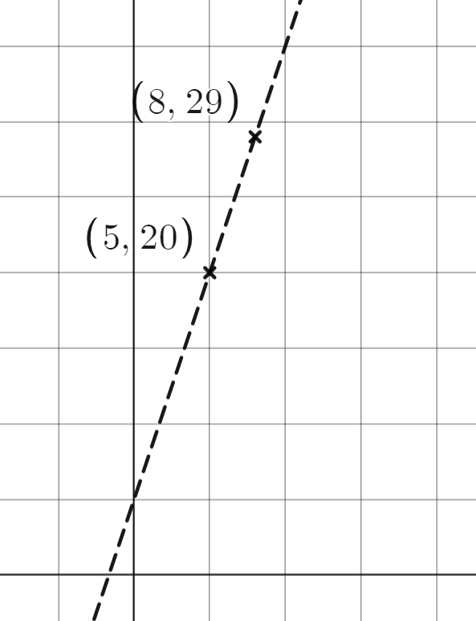
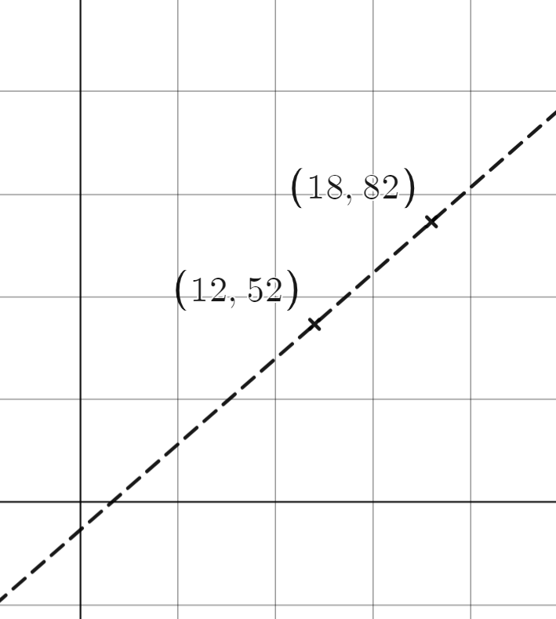
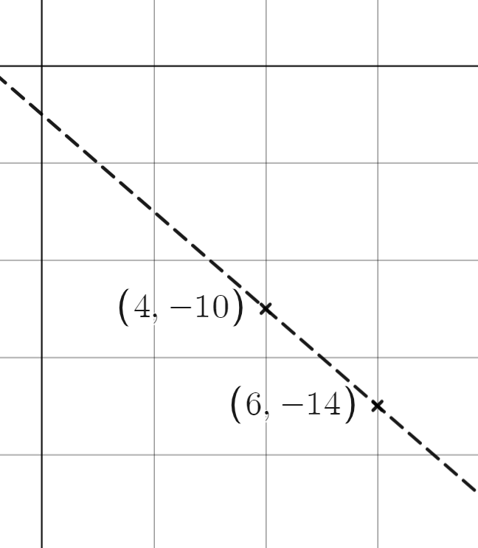

The intercept point
Task C: Calculating the y-intercept from two coordinates
1) For each pair of coordinates, work out the y-intercept for the line which passes through them.
a) (5, 20) and (8,29) | b) (12,52) and (18,82) | c) (4,−10) and (6,−14)
3 | 9
1
6
1
2 | −4
gradient =
gradient =
x | 0 | ….. | 5 | ….. | 8
y |  | ….. | 20 | ….. | 29
x | 0 | ….. | 12 | ….. | 18
y |  | ….. | 52 | ….. | 82
x | 0 | ….. | 4 | ….. | 6
y |  | ….. | −10 | ….. | −14
y-intercept = ( , )
y-intercept = ( , )
y-intercept = ( , )
d) (10,8) and (18,0) | e) (7,54) and (10,75) | f) (6,13) and (9,22)
gradient =
x |  |  | 10 | ….. | 18
y |  |  |  | …..
x |  |  | 7 | ….. | 10
y |  |  |  | …..
y-intercept = ( , )
y-intercept = ( , )
y-intercept = ( , )
Mathematics in Education and Industry
v2.2

